Slide 1



Ministry of Higher Education and Scientific Research
General Directorate of Technological Studies
Higher Institute of Technological Studies of Zaghouan
SECOND YEAR INTERNSHIP
Host company: ACT CONSULT
Elaborated by: Youssef Ben Salem
Professional Supervisor: Nizar Ben Salem
University year: 2022/2023

Slide 2
Roadmap
Implementation and interfaces
Presentation of the company
conception
1
3
5
2
4
6
Internship Context
Used technologies
conclusion

Slide 3
Presentation of the company
Act Consult :is a consulting firm specialized in quality management, food safety, innovation, environment, health, safety at work and good governance

Slide 4

Presentation of the company
Vision
Mission
Values
national and international partner in any sustainable approach to transfer, innovation and performance improvement.
Contribute to clients success and develop networking.
Respect, commitment, team spirit, openness and belonging.

Slide 5

Roadmap
Implementation and interfaces
Presentation of the company
conception
1
3
5
2
4
6
Internship Context
Used technologies
conclusion

Slide 6

Internship Context
An internship is an opportunity to gain real-world experience and integrate into professional life
Problem : The company has identified a need for standardization in their work to avoid confusion and repetitive questions during their travels
Solution : Developing a document management website that allows the administrator to manage permissions and document access while also making it simpler for users to retrieve the desired file

Slide 7
Roadmap
Implementation and interfaces
Presentation of the company
Conception
1
3
5
2
4
6
Internship Context
Used technologies
conclusion

Slide 8

Conception
Designing the architecture of the application

Slide 9
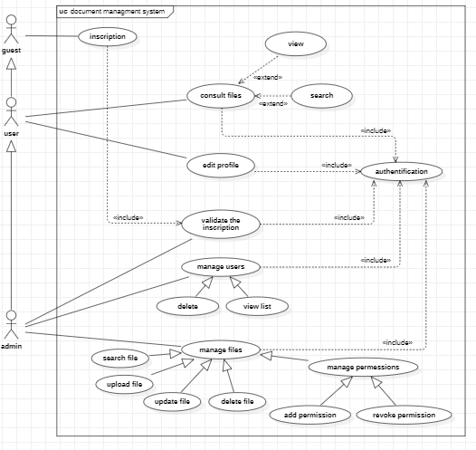

Use case diagrams show how users interact with the system, the functionalities the system offers
Use case diagram

Slide 10

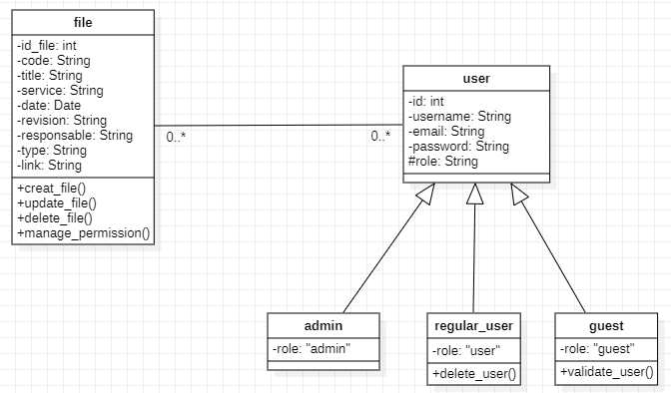
Class diagram help to visualize and describe the structure of the system
Class diagram
Internship Context

Slide 11
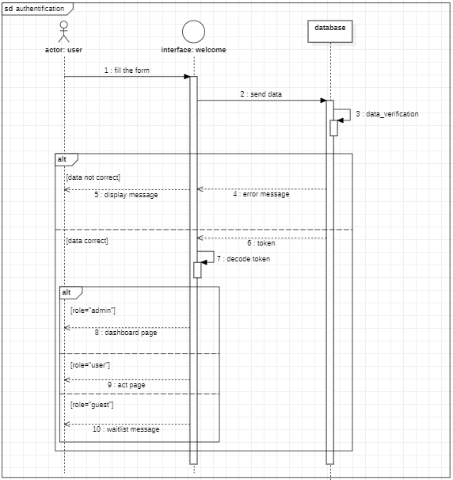

Initial Planning and conception
sequence diagram is a diagram that enables the representation of interactions between objects
Sequence diagram

Slide 12
Roadmap
Implementation and interfaces
Presentation of the company
conception
1
3
5
2
4
6
Internship Context
Used technologies
conclusion

Slide 13




Used technologies
Frontend
backend
databse
Understanding our needs and motivations is essential for making the best choices
User-friendly interface
Responsive design
Single page application
Integration with the backend API
Security measures
reliable
Fast processing
error handling
scalable and flexible API
Security measures
Efficient storage
Data security measures
Integration with the backend

Slide 14






Used technologies

Slide 15
Roadmap
Implementation and interfaces
Presentation of the company
conception
1
3
5
2
4
6
Internship Context
Used technologies
conclusion

Slide 16

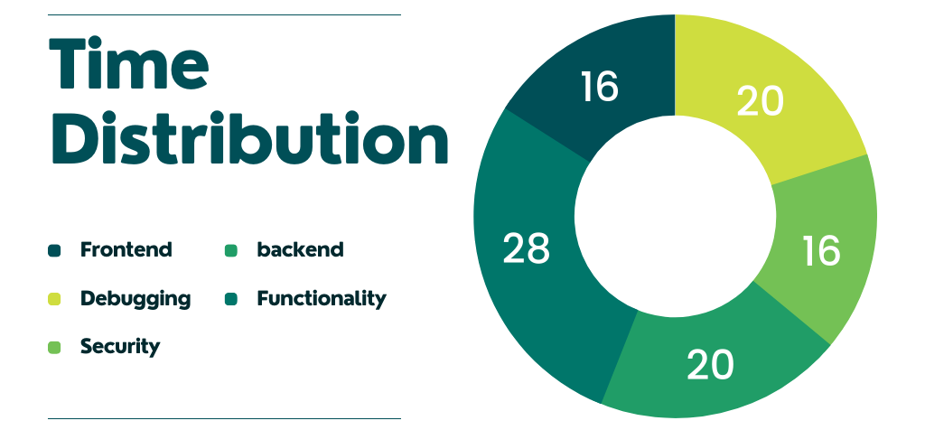
Implementation and interfaces
Set up development environment
Build the database and make the connection
handle the request on different routes
Develop the interfaces
Routing and security
Test and debug

Slide 17
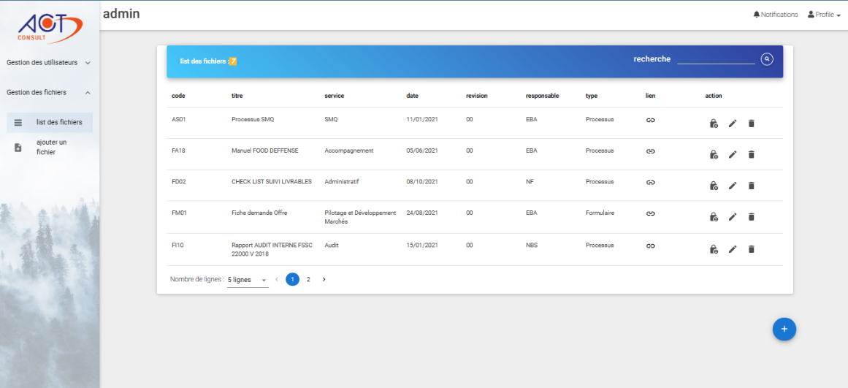
list of files (Admin view)
Manage permission
Edit file
Delete file
Redirect to upload page
File’s link

Slide 18
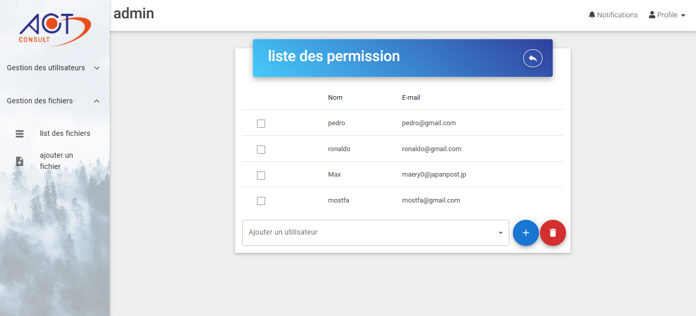
Manage permission
Redirect to file’s list
Delete selected users
Select the user to add

Slide 19
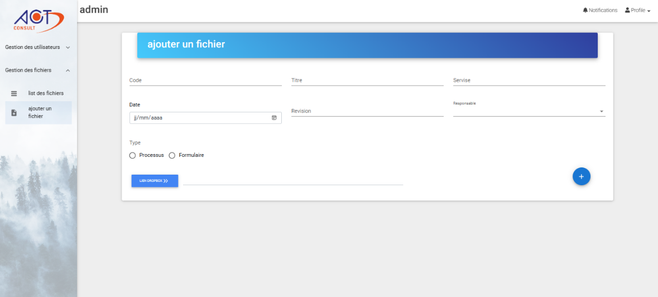
Upload page
Submit button
Insert the dropbox link

Slide 20
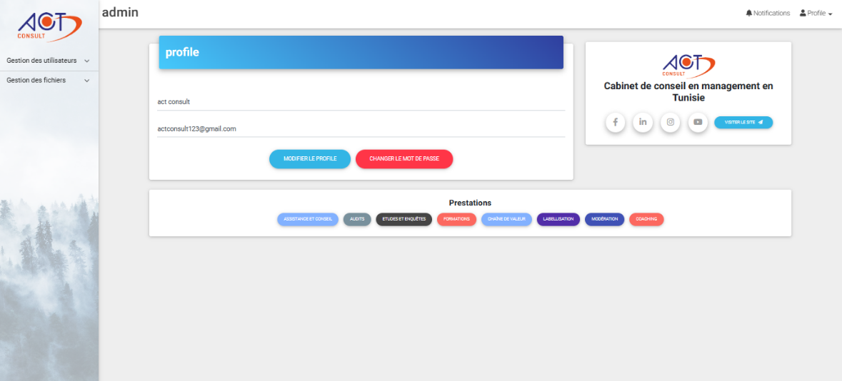
Update profile
Submit updates
Social media
Change password

Slide 21
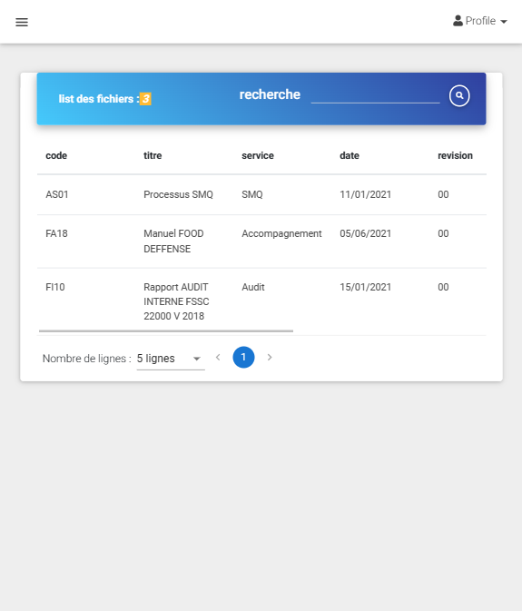
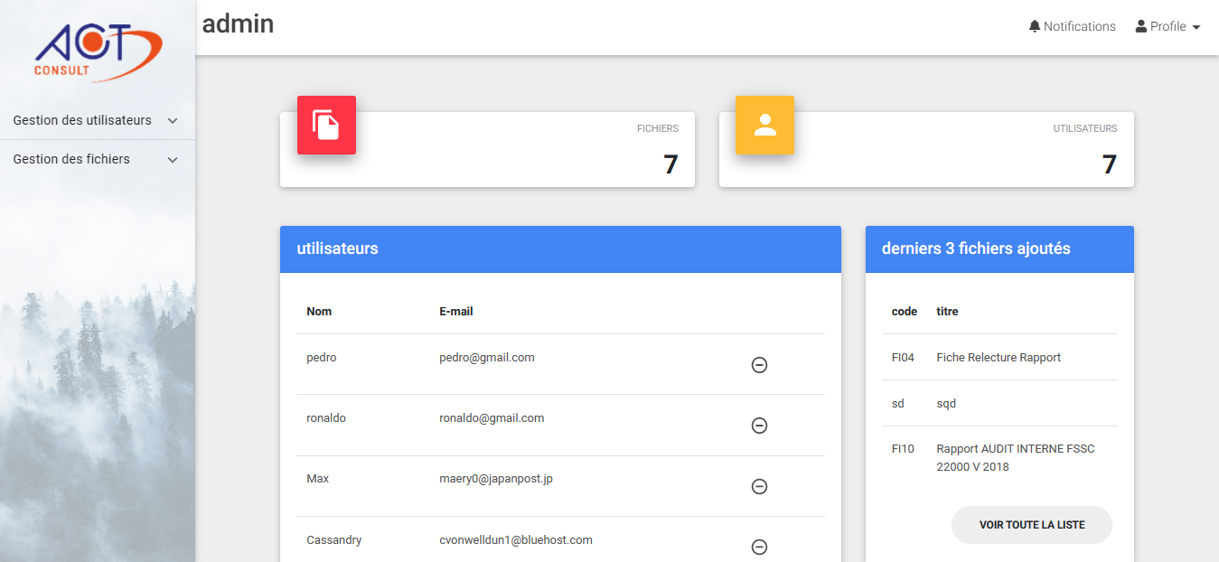
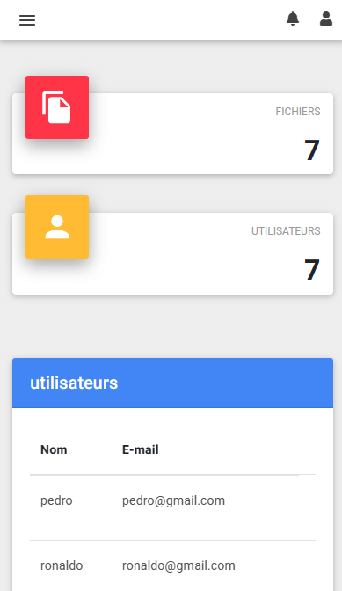

Responsive design

Slide 22
Roadmap
Implementation and interfaces
Presentation of the company
conception
1
3
5
2
4
6
Internship Context
Used technologies
conclusion

Slide 23





Conclusion and possible Enhancements
In conclusion, this internship offered a beneficial learning opportunity for the development of both technical and professional skills.
Google
authentification
Customizable
File Collections
Group chat
To-do list

Slide 24
Thank you for your attention

